Slide 1

Forestry in estonia
22.11.2025
Riido Rosin

Slide 2

About me:
MSc in Forest management
1990 - 1992 Aegviidu Metsamajand
1992 - 1998 Enterpreneur in trade
1998 - 2008 AS Stora Enso Eesti
2009 - 2021 Tornator Oyj
2021 - Enterpreneur

Slide 3
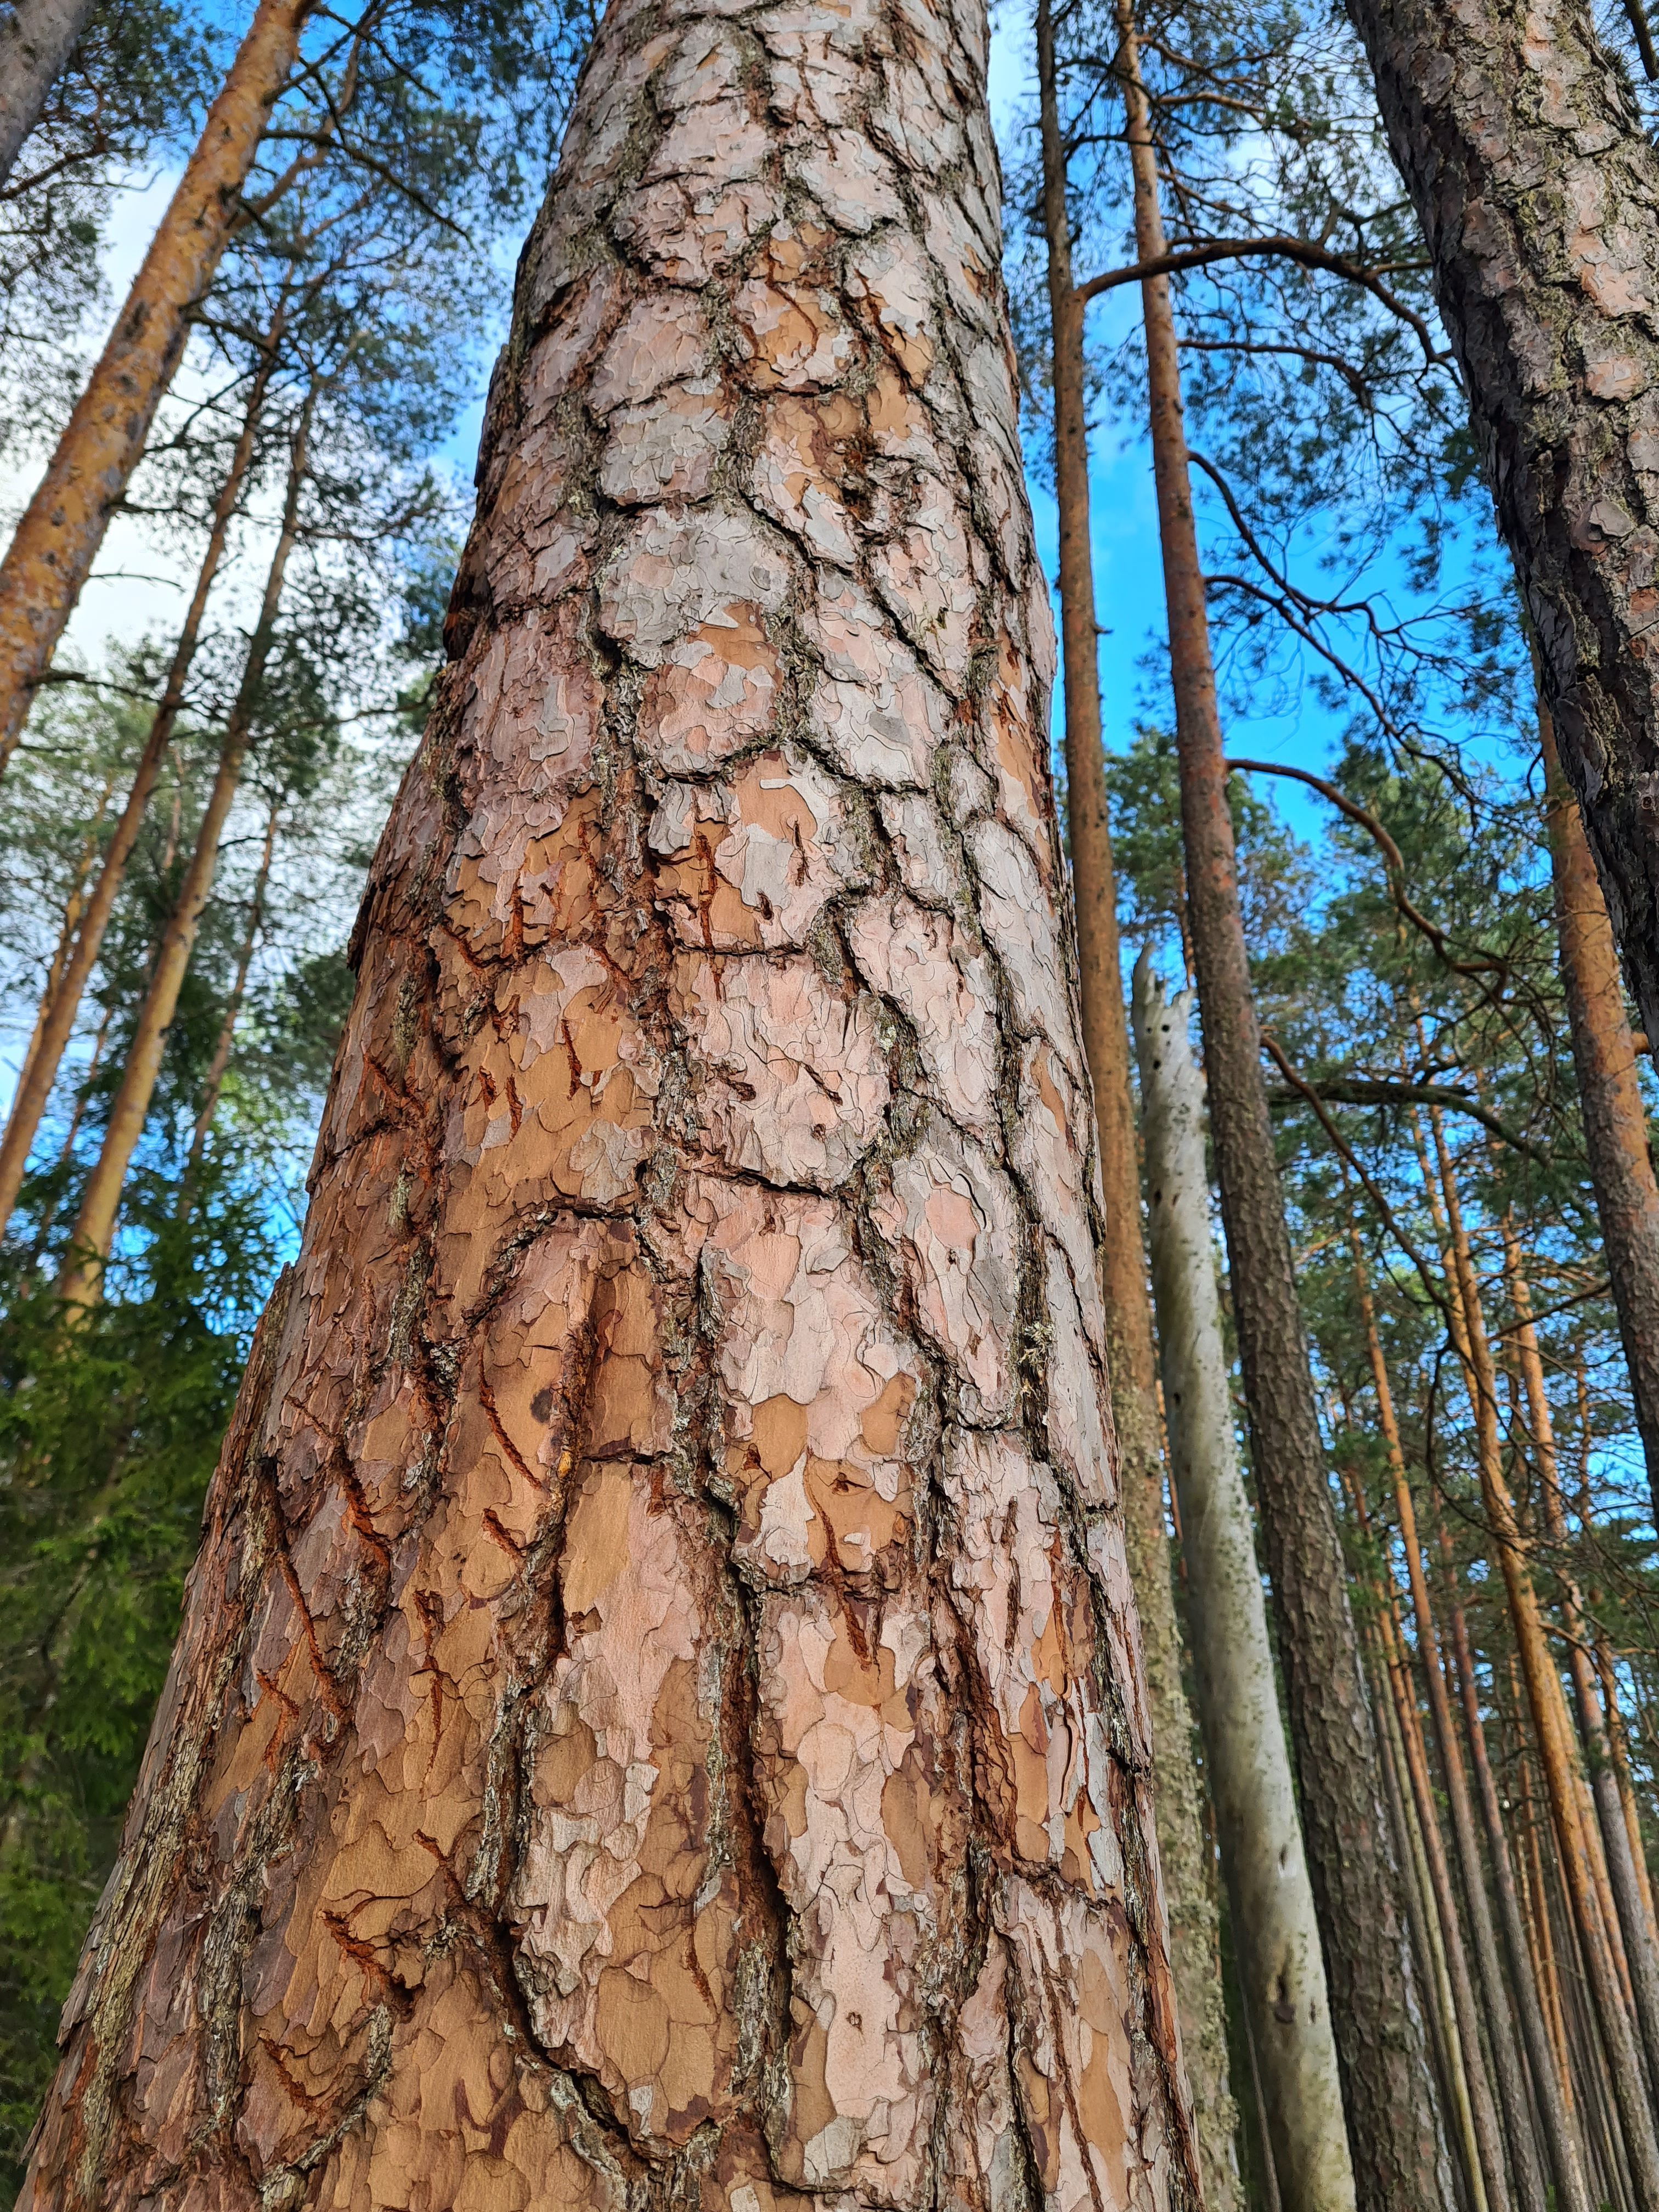
ESTONIAN FORESTS IN NUMBERS
(by Yearbook Forest 2023)
Total forest land 2,3 Mha 51,5% of total area
Growing stock 454 Mscbm
Managed forests 1,9 Mha 345 Mscbm
Majority species pine 28%
spruce 26%
birch 23%
others 23%

Slide 4
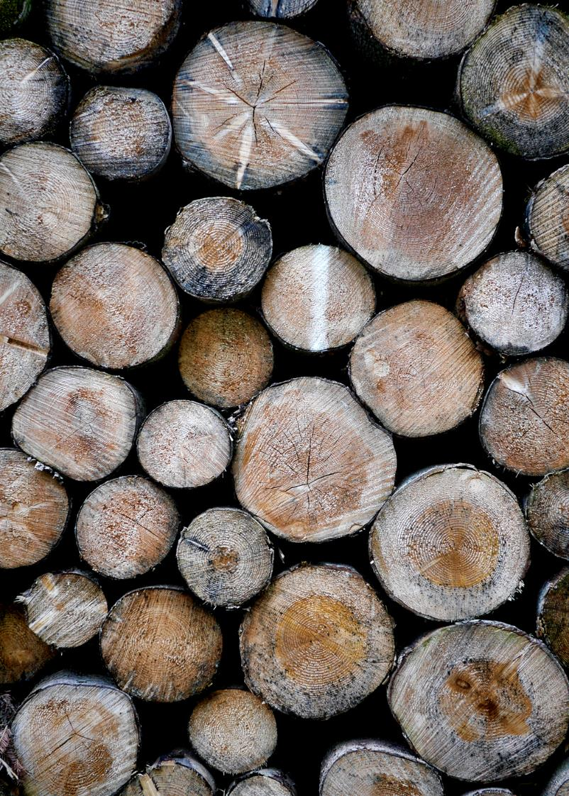
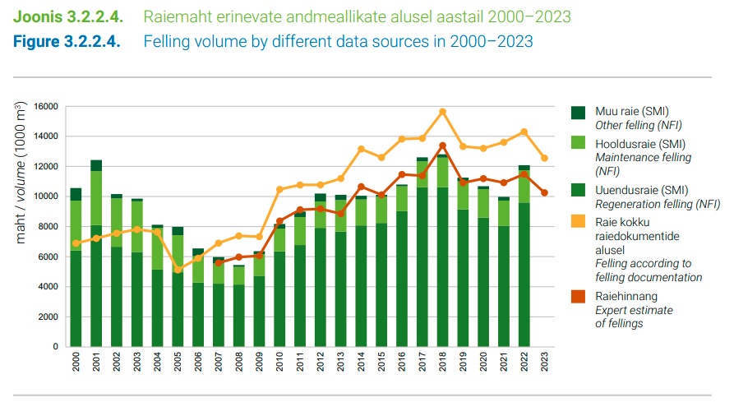
FELLINGS

Slide 5
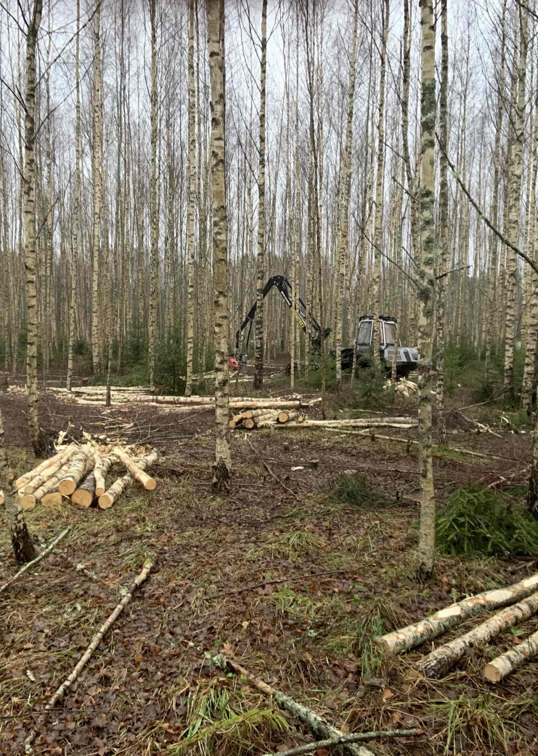
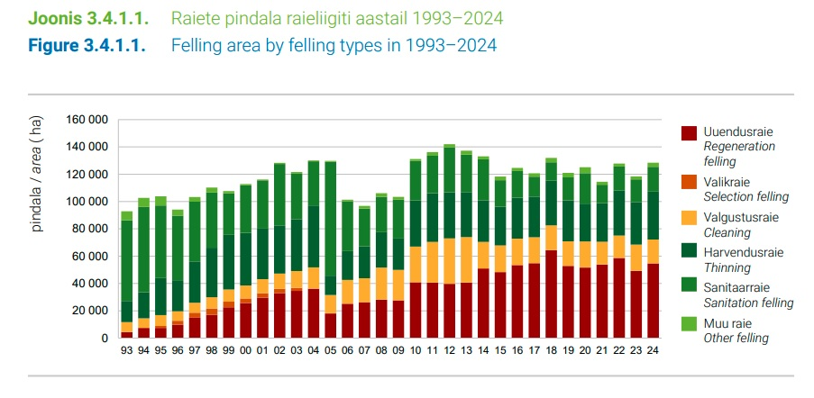
FELLING AREA BY FELLNG TYPES

Slide 6
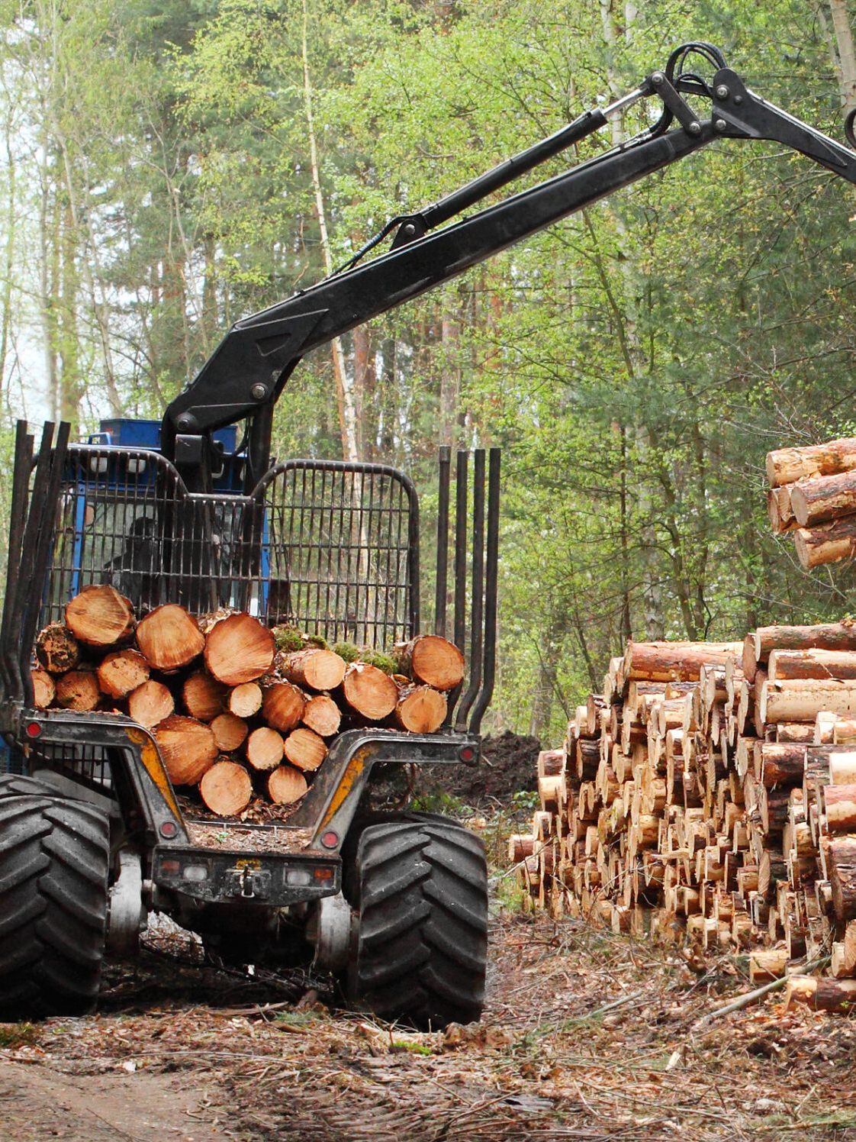
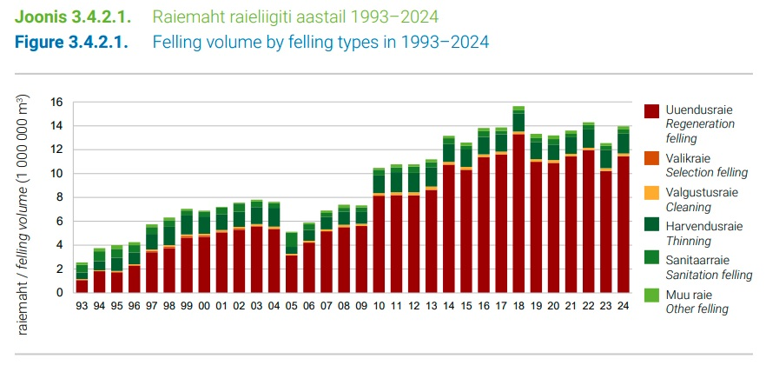
Felling volume by felling types

Slide 7
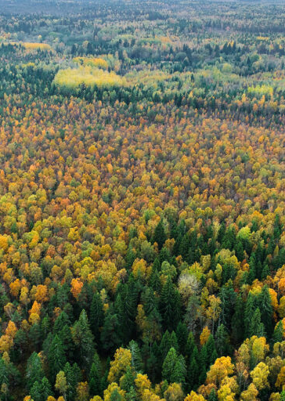
FOREST LAND OWNERSHIP
46% RMK (state forest)
49% private forest (private persons and companies)
5% ohter state forest land and forest land subject to privatization
Private forests ownership:
55% private persons
45% companies

Slide 8
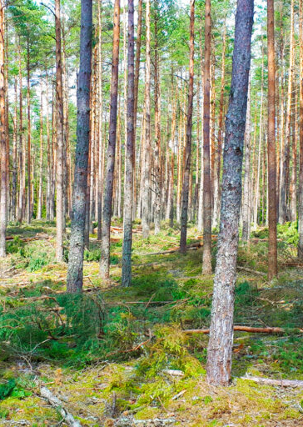
BIGGEST FOREST OWNERS (2025)
(by forest land area)
State 1 110 892 ha
Foreko 62 694ha
Tornator 58 245 ha
IKEA 24 795 ha (+15 680 ha)
Metsagrupp 18 995 ha
Vestman 18 961 ha

Slide 9

FOREST LAND TRANSACTIONS

Slide 10
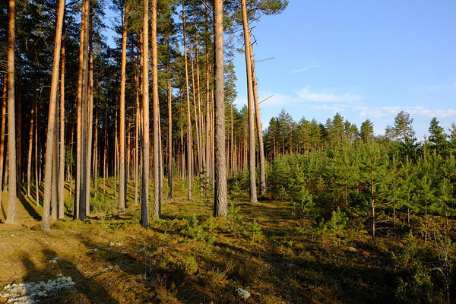
Basics of the forest management
Forest inventory data
  according to the Forest Act, valid inventory data is mandatory for regeneration and thinning felling (not older than 10 years)
Forest notification
  All fellings in stands with a diameter at breast height of more than 8 cm require a forest notification approved by the Environmental Board
Sales contracts
  Cutting right sale - agreed amount or based on out-come (main type of agreements in privat forestry)
  Timber sales contract – delivery or road-side (main type in RMK)
Membership in a forest association
  Required to receive most of subsidies. Support is provided for the purchase and planting of forest plants, the preparation of forest land, and the maintenance of reforestation if the forest has been logged or destroyed

Slide 11
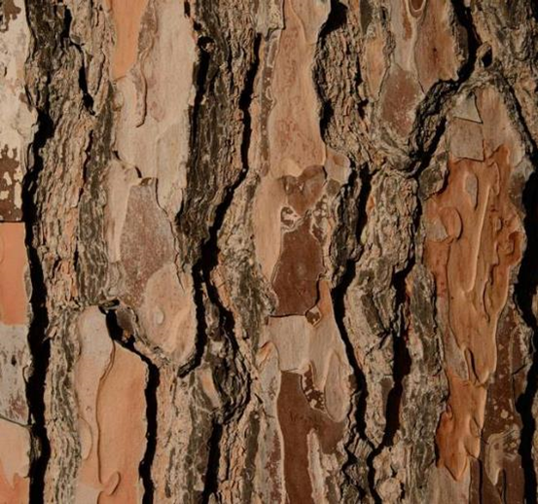
Specific features of estonian forestry
Measurements in timber trade are made without the bark
Machine measurement is mainly accepted in state forests; private forest owners usually lack trust in logging companies and should accept the measurement results of timber buyers.
The average number of assortments obtained from logging is significantly higher than in Finland.
Size of felling site is significatly smaller compared to Finland – the share of variable cost is higher

Slide 12
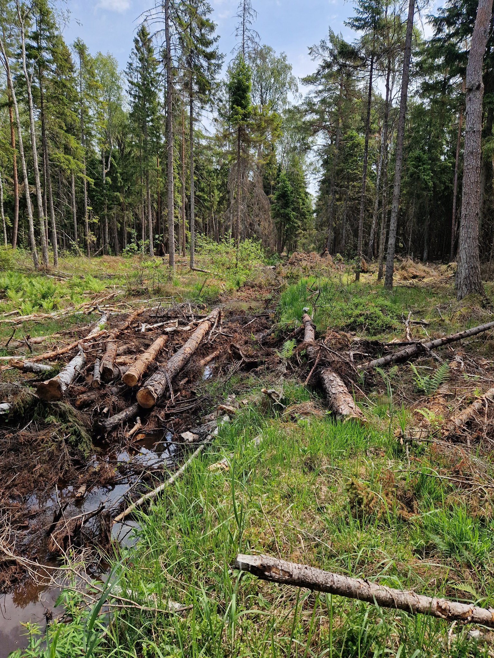
Forest policy
Greatest restrictions on forest management in the region
  nearly 20% of forest land is strictly protected, ca 14% of forest land has different kind of restrictions
Decreasing felling volumes due to age structure of forests
Enormous influence of NGOs on legislators and public opinion
  increasing restrictions in forestry without compensation
  public resistance to any logging activities
Interpretation of EU environmental acts (LULUCF, EU Nature Restoration Regulation)
  extreme eagerness of officals to take on excessive responsibilities
The balance between managed and protected areas proposed by the Ministry of Climate (70-30) hasn’t yet been established

Slide 13
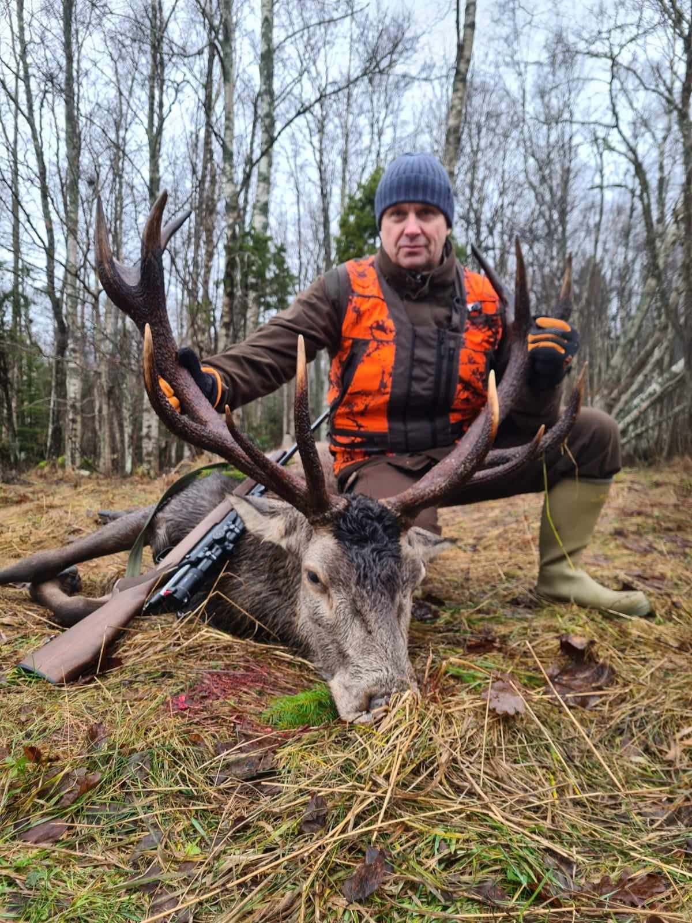
Thank you!
Riido Rosin
riido.rosin@gmail.com
Tel. +372 5056 845

